Slide 1



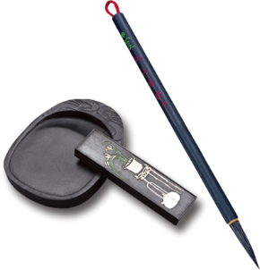
个人博客
汇报人：胡旭选
指导老师：李辉
丙申

Slide 2

肆 分析总结
叁 所遇问题
贰 项目展示
壹 项目简介
目录/contents
A designer can use default text to simulate what text would look like. If it is not real text. A designer can use default text to simulate what text would look like. If it is not real text. A designer can use default text to simulate what text would look like. If it is not real text. If it is not real text.

Slide 3
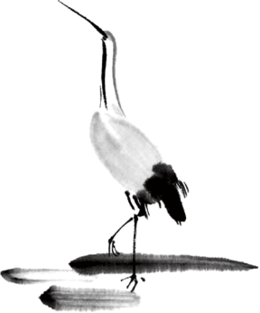
项目介绍
壹
贰
叁
肆
主页
详情页
关于我
新闻页

Slide 4
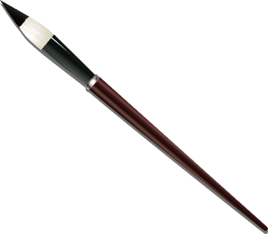

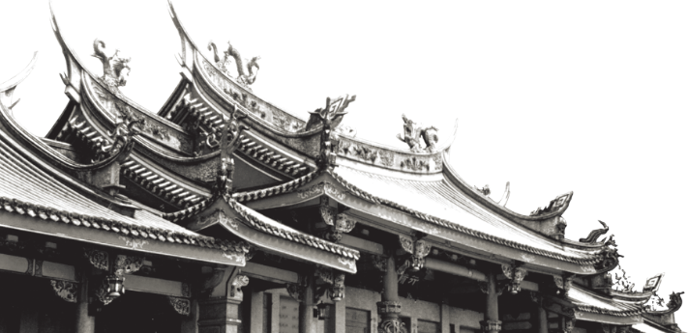
项目展示
A designer can use default text to simulate what text would look like.
A designer can use default text to simulate what text would look like. A designer can use default text to simulate what text would look like. A designer can use default text to simulate what text would look like.

Slide 5

所遇问题
壹
贰
叁
Worldwide Business
Business To Go
Creative Solutions
网页设计
网页效果实现
网页效果与
所学知识联系
肆
Market Assessment
调错能力

Slide 6
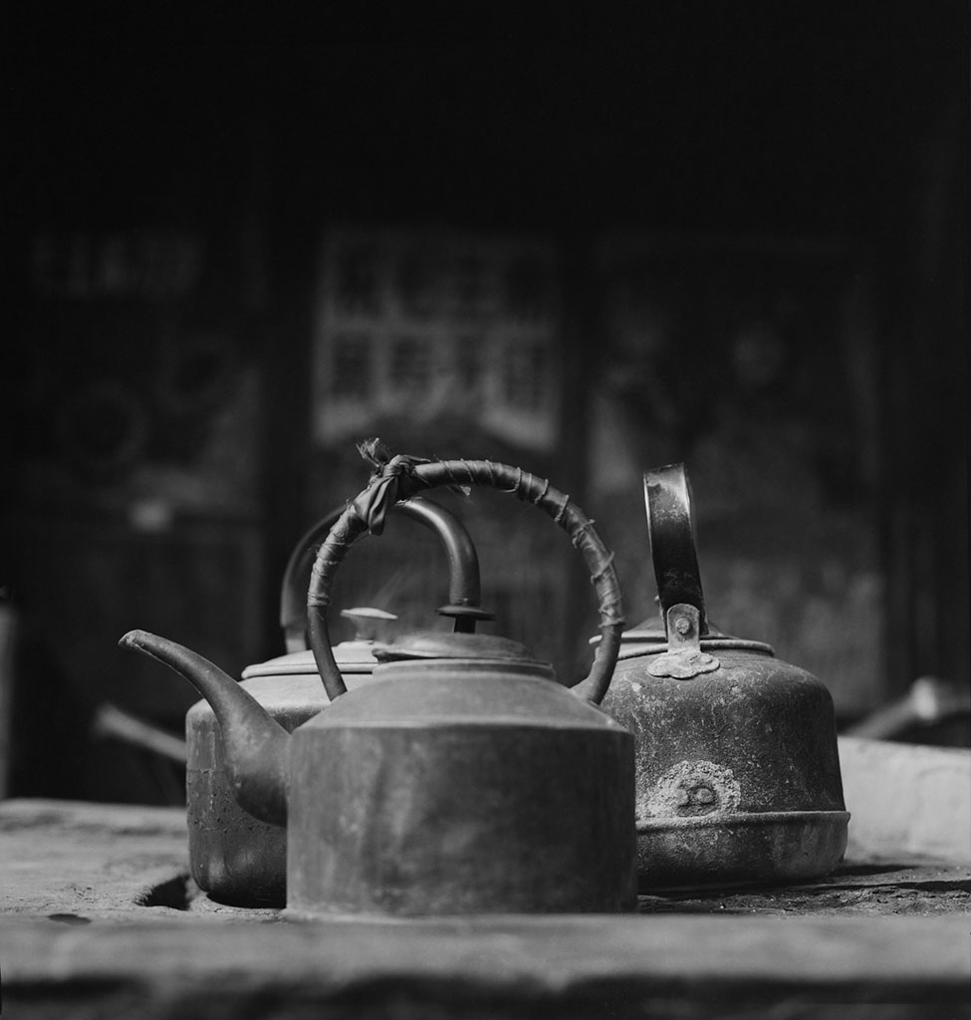
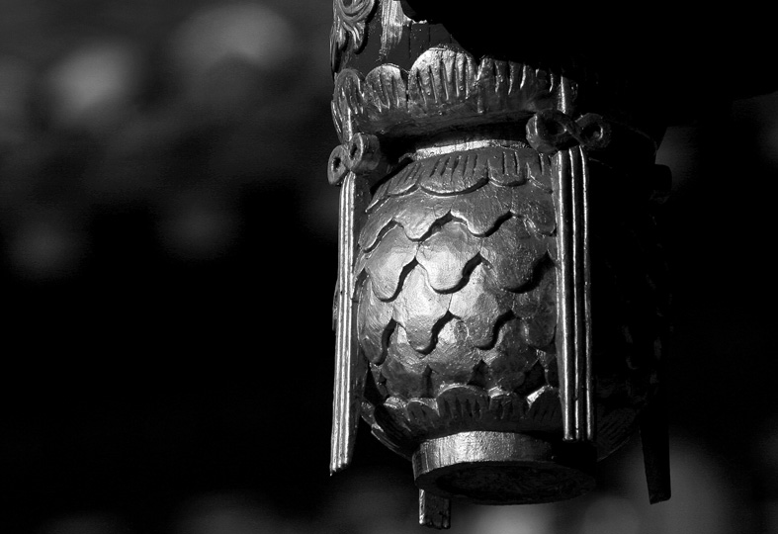
分析总结
A designer can use default text to simulate what text would look like. A designer can use default text to simulate what text would look like. A designer can use default text to simulate what text would look like. A designer can use default text to simulate what text would look like. 、

Slide 7
人生若只如初见，何事秋风悲画扇。
等闲变却故人心，却道故人心易变。
骊山语罢清宵半，泪雨零铃终不怨。
何如薄幸锦衣郎，比翼连枝当日愿。
中 国 风

Slide 8


致谢
感谢您的聆听！

